Slide 1
GADC IT System Hand Over 1st Assignment
Prepared by: kanel roath (IT consultant)
E-mail: roathkanel@gmail.com
HP: (+855) 12 578 871 (Telegram, whatsapp, viber, line)

Slide 2
TOC
Completed Tasks.
Gadc IT Components.
Hand over documents.
Fund raising, budget allocation, cash flow management (IT).
Future IT Management and Services.

Slide 3
Completed Task
Clean up current web hosting (100%)
Anti-virus license deployment (100%): Client and server.
Coordinate process of changing Internet Service Provider (ISP) (50%): Procurement on ISP is in progress.
Purchase and configure Business wifi access point (100%): Recommend one more point for Finance room.

Slide 4


Gadc IT Component (External overview)
INTERNET
Gadc E-mail
(Microsoft 365)
Google
Youtube
Gadc DNS
(MPTC)
Facebook
Gadc Website
(Host Cambodia)
Cogetel Online

Slide 5



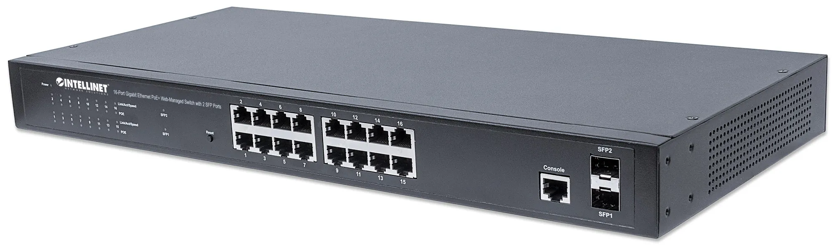

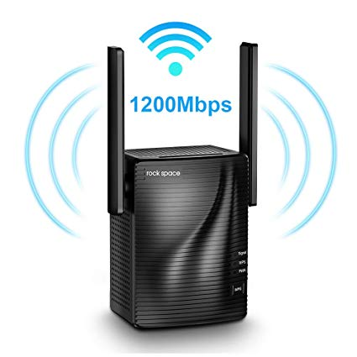
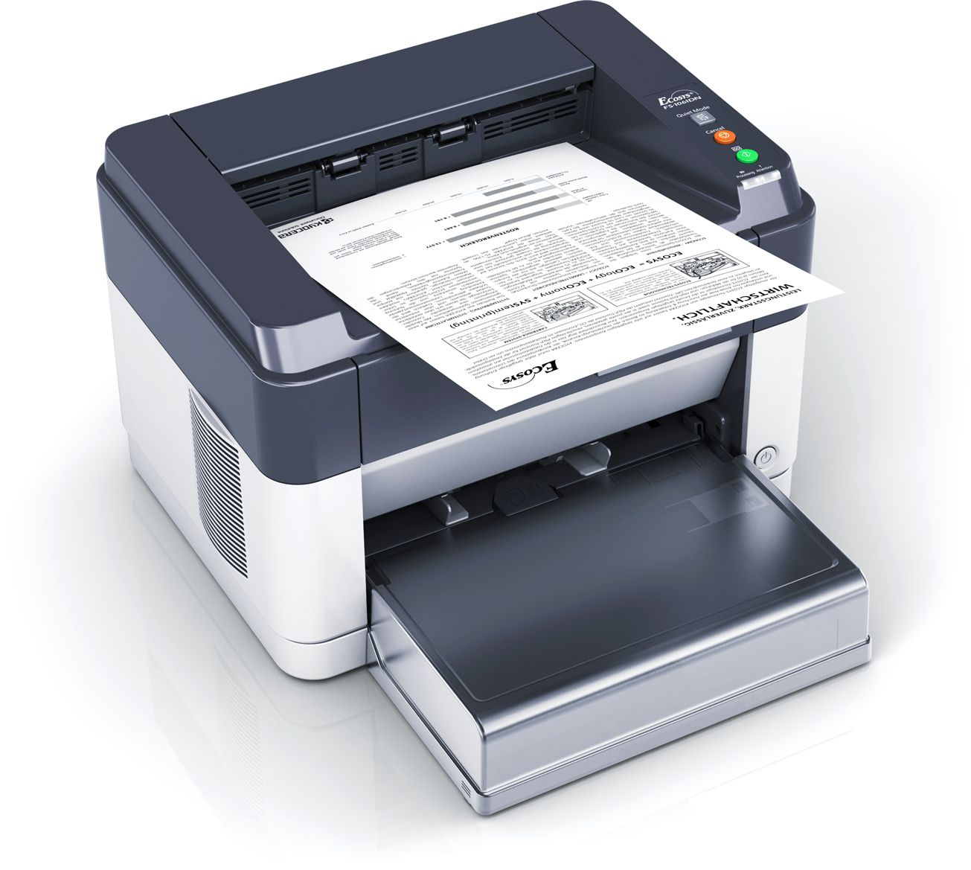
Gadc IT Component (Internal overview)

Slide 6
Gadc IT Component (List equipment)
Firewall: 1.
Switch: 2 (1 Gigabyte, 1 Ethernet).
Photocopy: 1.
Printer: 4 working.
Wifi: 5 points.
Desktop PC: 3.
Laptop: 16 or over.
Server: 1.

Slide 7
Hand Over Documents
Password document:
Server, Router, Printer, Website, Administrator account, cPanel (website and e-mail management)…
Wifi: Production and Guest.
Staffs E-mail account.
Software for Gadc: Ms. Office, Acrobat, Khmer keyboard…
Driver for Gadc IT equipment: Photocopy, printer, wireless network card, laptop, desktop…
License information: QuickBook, Windows License, Norton Anti-virus (client), Symantec Anti-virus (Server).

Slide 8
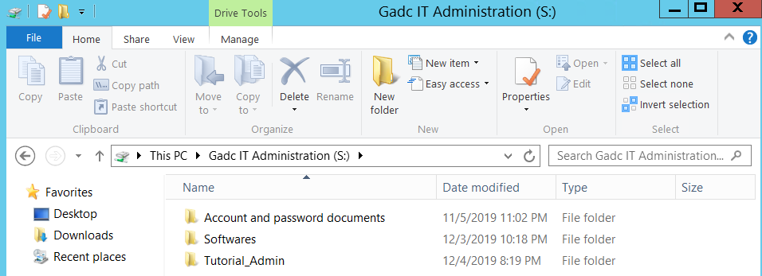
Hand Over Documents: IT Administration
Contain information for IT technical person and management.
Secret IT information for Gadc.
Do not share with user.
Starting point to manage and hand over.

Slide 9
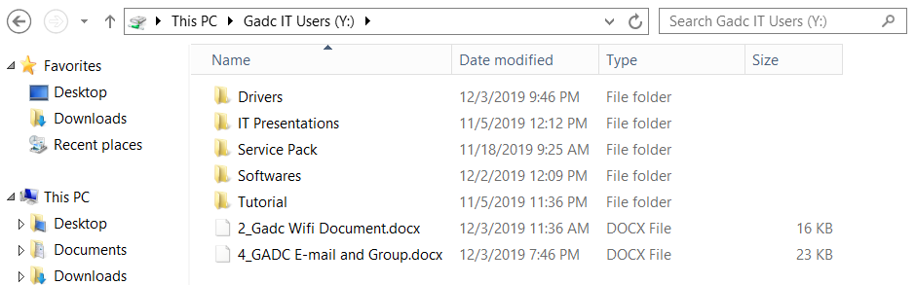
Hand Over Documents: IT Users
Contain information for IT stuffs share with Gadc staffs..
Frequently use by IT to setup system for user.
Share across internal Gadc staffs.
Do not share to External Gadc.

Slide 10
Fund raising, budget allocation, cash flow management (IT)
Fund raising from Donor. Allocate for IT.
Use from other source of available budget. Good for one time purchase equipment/service.
Gadc has private income? Not sure. Discuss during presentation. If yes, use for subscription service. Ensure long term running service.
Cash flow management:
Long Supported budget/private income should be using with subscription service.
Long term subscription service should 6 months or yearly basis. Have plenty of time to plan, fund raising, budget allocation. Exp: Internet service, Ms. Office, Adobe product, Anti-virus, web hosting…
Short term budget/one time budget should purchase IT equipment/one time service. Exp: Synology NAS, Windows License, External HDD for backup, Memory upgrade, Printer…
Other: promotion period, discount, maintenance… Use only available at procurement time and compliance with Gadc policy.

Slide 11
Future IT Management and Services
Backup internal staff, backup internal IT staffs.
Outsourcing IT service with proper documentation, training and hand over process.
Require software license: Office, Windows, Adobe… Any other software require to accomplish Gadc business.
Synology NAS: Cloud hosting and sharing resource, backup media and cloud services (if budget available).

Slide 12
Q&A

Slide 13
Thank You!

